Slide 1
FAMILY ASFARVIRIDAE
(African Swine Fever virus)

Slide 2
Baltimore group I
The name Asfarviridae is derived from African Swine Fever And Related viruses.
ASFV was first classified as a member of the family Iridoviridae because of its large size, cytoplasmic location, and double-stranded DNA genome.
However, studies of replication strategy and the genome revealed similarities with the Poxviridae, although the viruses differ structurally.
ASFV was therefore placed as the species African swine fever virus into a separate virus family, the Asfarviridae, of which it is the sole member of the single genus, the Asfivirus genus.

Slide 3
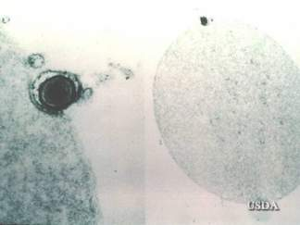
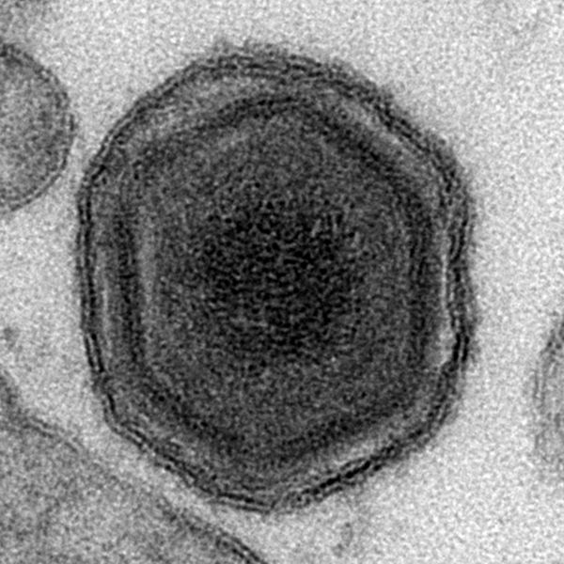
ASF virus
Large (~ 200 nm) spherical or pleomorphic, lipoprotein-enveloped, icosahedral symmetry
double- stranded DNA virus
ASFV is the only DNA virus that can qualify as an arbovirus, soft ticks of the Ornithodoros genus
Replicates in the cytoplasm and produces acidophillic intracytoplasmic inclusion bodies
Notes:
USDA PIADC

Slide 4
Morphology
The ASFV particle has an icosahedral morphology composed of several concentric domains: the internal core formed by the central genome contains the nucleoid, which is coated by a thick protein layer named core or matrix shell;
an inner lipid membrane surrounding the core;
and finally the capsid, which is the outermost layer of the intracellular virions.
The extracellular virions possess an additional external envelope that is obtained when the virus buds out through the plasma membrane.
The viral genome -single molecule of linear, covalently close-ended, double stranded DNA.

Slide 5
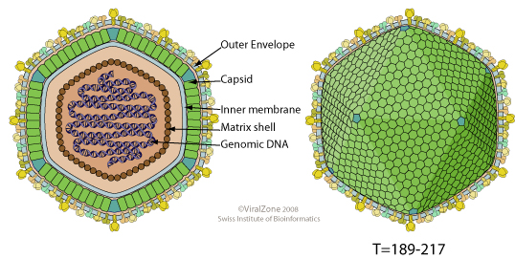

Slide 6
VIRAL REPLICATION
Replication occurs primarily in the cytoplasm, although the nucleus is needed for viral DNA synthesis.
Viral attachment is via a specific receptor and entry into host cells is via endocytosis.
After entry into the cytoplasm, virions are uncoated and their DNA is transcribed by a virion-associated, DNA-dependent RNA polymerase (transcriptase) – early mRNA synthesis
Notes:
Like the poxviruses, virions contain genes for all the machinery necessary for transcription and replication; DNA replication is believed to be similar to that of poxviruses;

Slide 7
Viral DNA replication and assembly take place in perinuclear areas.
Parental genomic DNA serves as the template for the first round of DNA replication, the product of which then serves as a template for the synthesis of large replicative complexes that are cleaved to produce mature virion DNA.
Formation of the capsid takes place on two layers of membranes derived from the endoplasmic reticulum (ER); extracellular virus acquires a membrane by budding through the cellular plasma membrane.

Slide 8
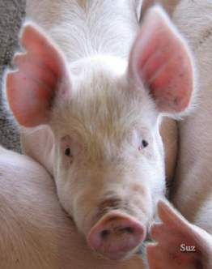
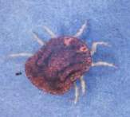
African Swine Fever
African Swine Fever is a tick-borne, contagious, febrile, systemic viral disease of swine.
Highly contagious viral disease of domestic pigs with up to 100% mortality
Pigs die as a result of a hemorrhagic fever.
Is a serious transboundary animal disease with the potential for rapid international spread by live or dead pigs, domestic or wild, and pork products;
also via contaminated feed and fomites (non-living objects) such as shoes, clothes, vehicles, knives, equipment etc. due to the high environmental resistance of ASF virus.
http://www.iah.bbsrc.ac.uk/images/Asfvirus.gif

Slide 9
African Swine Fever
Morbidity:
High morbidity — usually 100% in pigs that have
contact with one another; 100% in naïve pigs
Mortality:
Highly virulent isolates have about 100% mortality
Moderately virulent isolates range from low percentage to 60-70%.
There is no vaccine for African Swine Fever

Slide 10

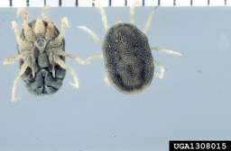
Host Range
Ornithodoros or soft ticks are believed to be the original host. Numerous isolates have been made from the soft tick Ornithodoros moubata
Notes:
www.forestryimages.org/ images/768x512/1418023.jpg
Green - DEFRA

Slide 11
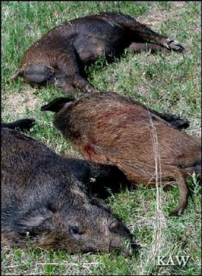
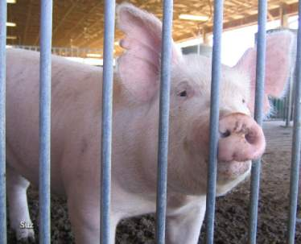
Host Range
ASFV is believed to be a tick virus with domestic pigs and wild pigs as accidental hosts.
Notes:
Suz and KAW

Slide 12
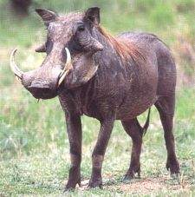
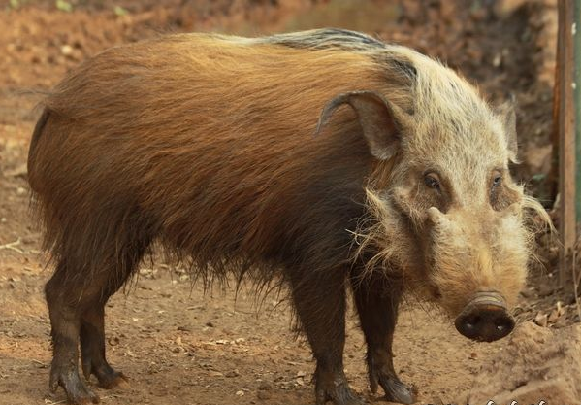
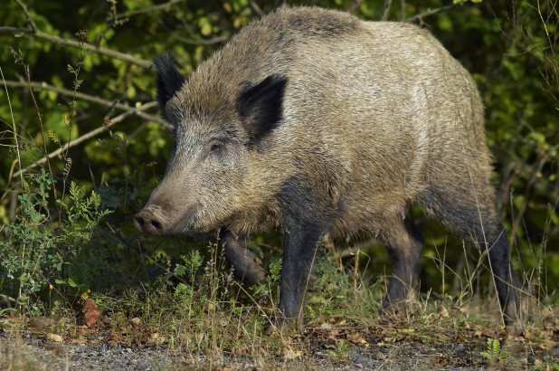
Host Range
In Africa:
Warthogs
Bush pigs
Giant forest hogs
In Europe:
Wild pigs
http://www.cruisersafaris.com/images/trophy/warthog_tf.jpg
Notes:
http://www.cruisersafaris.com/images/trophy/warthog_tf.jpg

Slide 13
Epidemiology
Two distinct epidemiologic patterns occur: a sylvatic cycle in warthogs in Africa and epidemic and endemic cycles in domestic swine.
Sylvatic Cycle involving asymptomatic infection in wild pigs (warthogs and, to a lesser extent, bush pigs) and argasid ticks (soft ticks, genus Ornithodoros), which occur in the burrows used by these animals.
After feeding on viremic swine,the virus replicates in the gut of the tick and subsequently infects its reproductive system, which leads to transovarial and venereal transmission of the virus.
Notes:
USDA PIADC

Slide 14
The virus is also transmitted between developmental stages of the tick-transstadial transmission-and is excreted in tick saliva, coxal fluid, and Malpighian excrement.
After primary infection, young warthogs develop viremia sufficient to infect at least some of the ticks feeding on them.
Older warthogs are persistently infected but are seldom viremic.
It is therefore likely that the virus is maintained in a cycle involving young warthogs and ticks.

Slide 15
Domestic Cycle
Primary outbreaks of African swine fever in domestic swine in Africa probably result from the bite of an infected tick, although tissues of acutely infected warthogs, if eaten by domestic swine, can also cause infection.
Introduction of the virus into a previously non-infected country may result in indigenous ticks becoming infected and acting as biological vectors and reservoirs of disease~a feature of great epidemiologic significance.

Slide 16
Once the virus has been introduced into domestic swine, either by the bite of infected ticks or through infected meat, infected animals form the most important source of virus for susceptible swine.
Disease spreads rapidly by contact and within buildings by aerosol.
Mechanical spread by people, vehicles, and fomites is possible because of the stability of the virus in swine blood, feces, and tissues.

Slide 17
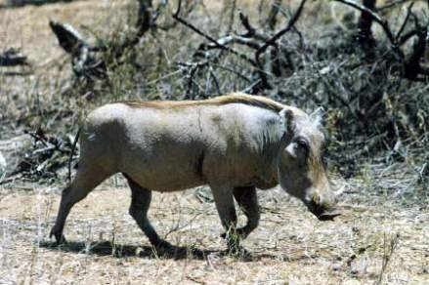
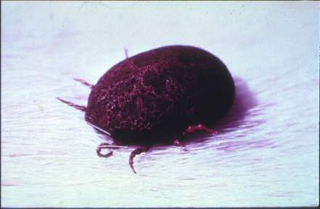
Transmission
Transmission by contact and ticks
Notes:
Images from Dr Corrie Brown

Slide 18
Transmission
Ingestion → Tonsil → Local LNs → Viremia
Virus in excretions and secretions, blood.
Carrier pigs incriminated in maintaining infection in herds.
Pigs with mild forms of ASF may shed virus for ~ 30 days.
Bites of infected ticks.

Slide 19
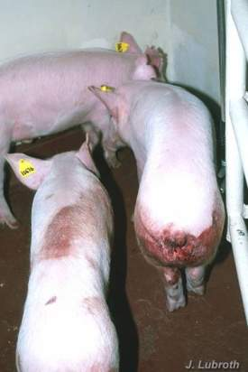
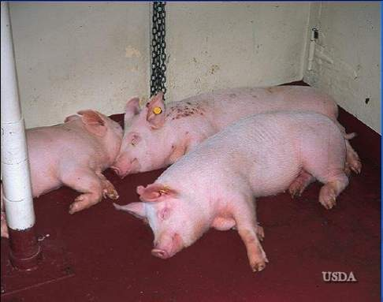
General Clinical Signs
HOT, SICK, RED pigs
Notes:
corrie

Slide 20
General Clinical Signs
In contrast to pigs with hog cholera:
  African Swine Fever pigs do not develop conjunctivitis or encephalitis
  Despite high fever, ASF infected pigs stay in good condition, whereas hog cholera infected pigs drastically lose weight

Slide 21
Abortion
Occurs whether isolates are high, moderate or low in virulence.
- Fetuses may be anasarcous.
- May find petechiae in placenta, skin, and
myocardium, and a mottled liver.

Slide 22
Clinical Signs
The predilection of ASF viruses for cells of the monocyte/ macrophage lineage results in major defects in the immune system of infected pigs
Coagulopathy, abnormal clotting
Thrombocytopenia
Hemorrhages
Sudden death in peracute cases
High fever, low appetite, huddling, shallow breathing, reluctant to move
Notes:
mvv

Slide 23
Clinical Signs
These signs are influenced by the virulence and the physiological state (age, pregnancy status)
There are three categories:
  Highly Virulent Isolate
  Moderately Virulent Isolate
  Low-Virulent Isolate

Slide 24
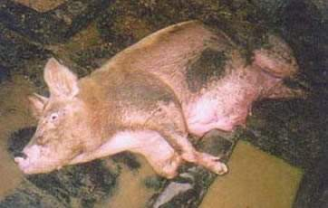
Clinical Signs:
Highly Virulent
Pigs eat and move less
Most die between 7 and 10 DPI.
It is not unusual to see
a pig walking and find
it dead a short time later
http://www.defra.gov.uk/animalh/diseases/images/v2/asfn_8.jpg
Notes:
Image from: http://www.defra.gov.uk/animalh/diseases/images/v2/asfn_8.jpg
DPI Days post-infection

Slide 25
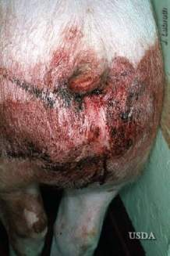
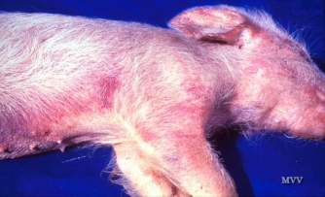
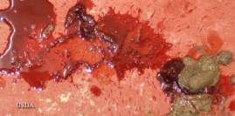
Clinical Signs
Peracute
- Sudden death
Acute
- Fever (105-107ºF) –
-Discolored skin
- Huddling
- Diarrhea /
melena
- Abortions
- Death
Notes:
PIADC

Slide 26
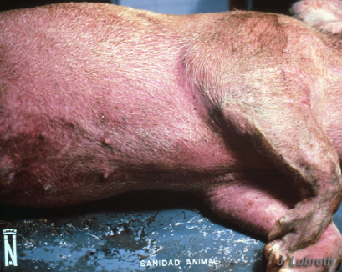
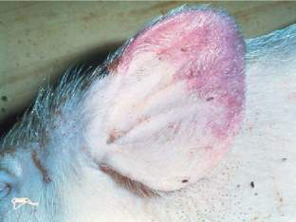
Clinical Signs
Erythema of skin:

Slide 27
Clinical Signs:
Moderately Virulent
Infected pigs usually have high fever for 10 to 12 DPI. Some mortality occurs at this time.
After 12 to 14 DPI, temperatures and leukocyte count begins to return to normal levels.

Slide 28
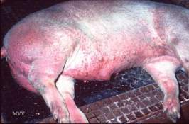
Clinical Signs:
Moderately Virulent
Very young pigs may have high mortality rate and lesions similar to those caused by highly virulent isolates

Slide 29
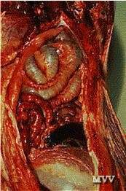
Clinical Signs:
Moderately Virulent
Some pigs will die at 7 to 8 DPI, frequently caused by hemorrhage into the stomach
Underlying causes: ASF infection causes prolonged bleeding time
Notes:
http://www.vetmed.iastate.edu/departments/vdpam/swine/diseases/chest/hogcholera/Swine%2044.gif

Slide 30
Clinical Signs:
Low-virulence
Many non-pregnant animals infected with low-virulence isolates may seroconvert but not show other signs of infection
Pregnant animals will abort

Slide 31
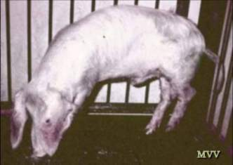
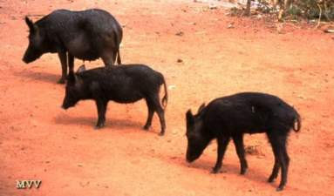
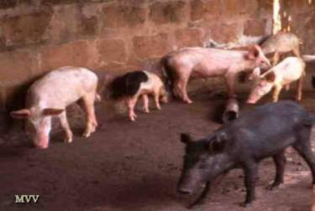
Clinical Signs:
Chronic
Transient / recurrent fever
Stunting / emaciation
Pneumonia
Skin ulcers
Notes:
May lose coordination, stunted, heart and lung lesions
Chronic cough
Fluid in pericardial sac: fibrinous endocarditis
Joint inflammation
Decubitous lesions on boney prominenses

Slide 32
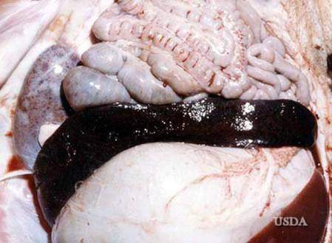
Gross Lesions
Highly Virulent Virus
Peracute deaths
- Lesions may be poorly developed
Animals that die 7 or more DPI
- Classic lesions likely.

Slide 33
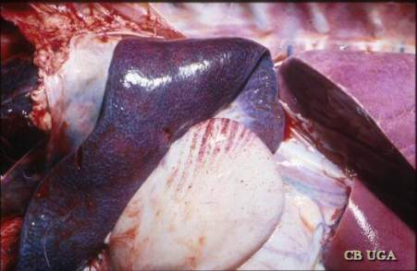
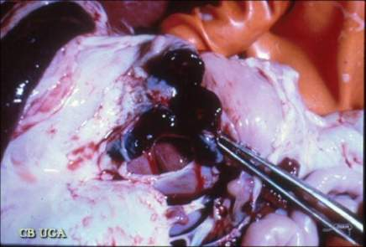
Lesions
Swollen necrotic spleen
Hemorrhagic gastro-hepatic lymph nodes
Notes:
Dr Corrie Brown University of Georgia

Slide 34
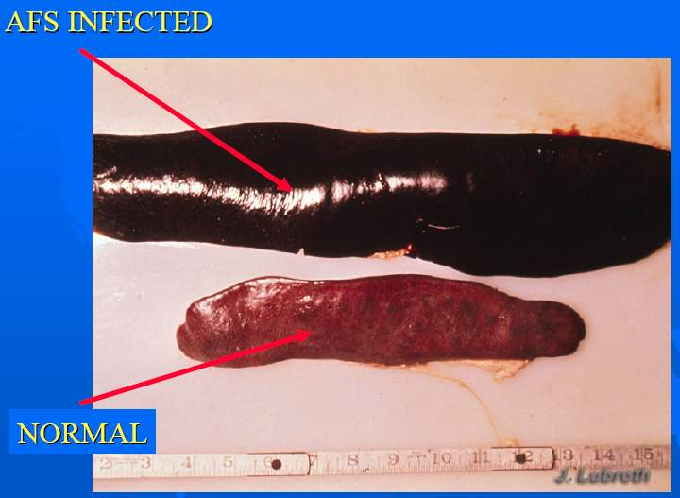
Splenomegaly

Slide 35
Gross Lesions
Moderately Virulent Virus
From 8-12 DPI
- Gross lesions are similar whether pigs are infected with a moderately virulent or highly virulent ASFV.
The main difference between these two types of isolates:
- Splenomegaly is still present,
- More normal color and is not friable.
Notes:
DPI Days Post-Infection

Slide 36
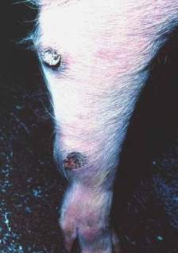
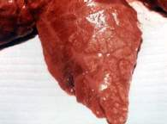
Gross Lesions
Low Virulence Virus
The most common lesions in chronic ASF:
-Necrotic skin lesions
-Consolidated lung lobules
-Generalized lymphadenopathy
-Swollen joints
-Pericarditis

Slide 37
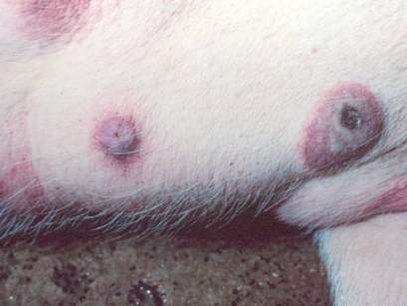
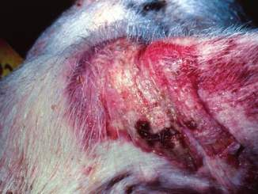
Chronic ASF:
Necrotic skin lesions
Raised reddened areas with
central areas of necrosis
Raised reddened area
behind the ear.

Slide 38
Diagnosis
African Swine Fever should always be suspected where there are febrile pigs
Necropsy findings include:
  Greatly enlarged spleen, dark red to black in color, friable spleen
  Very enlarged, hemorrhagic gastrohepatic lymph nodes
  Very enlarged, hemorrhagic renal lymph nodes

Slide 39
Diagnosis
Hog Cholera vs. African Swine Fever
  ETIOLOGY ?
  Hog cholera infected pigs become depressed and lose weight, whereas ASF infected pigs have neither symptoms
  Hog cholera is also characterized by a foul-smelling diarrhea

Slide 40
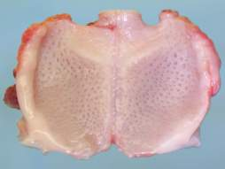
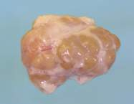
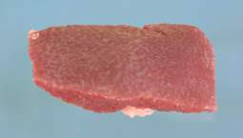
Diagnosis
Laboratory Specimens
Serum / clotted blood
EDTA, heparin blood
Lymph nodes
Spleen
Tonsil
Lung
Liver
Kidney
Notes:
piadc

Slide 41
Laboratory Diagnosis
Virus isolation
- Haemadsorption test (HAD) of leukocyte cultures.
- Haemadsorption autorosette test of Peripheral Blood Leucocytes(PBL) of suspect pigs.
Pig inoculation
- Requires inoculation of naïve and CSF- vaccinated pigs.
- Not recommended with newer tests available.

Slide 42
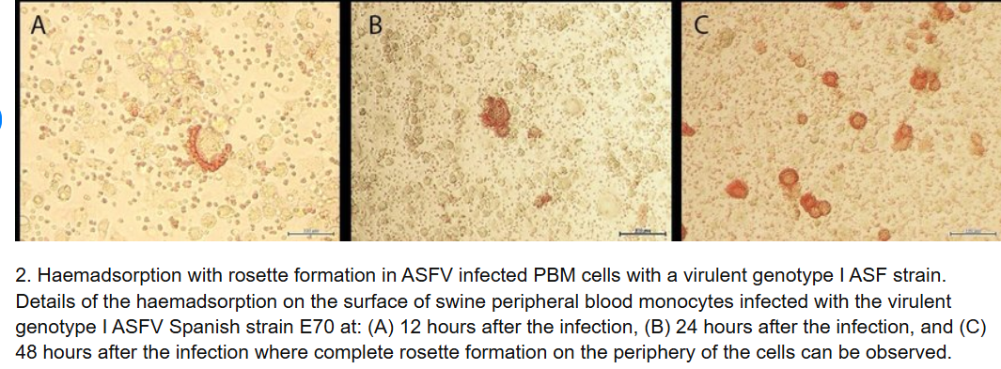

Slide 43
Diagnosis
Virus antigen detection
- Direct fluorescent antibody test (DFAT)
Virus genome detection
- Polymerase Chain Reaction (PCR)
- PCR-based sequencing method which permits detection and characterization of ASFV variants.
- Useful for molecular epidemiological clarification of ASFV
Notes:
Bastos, Penrith, Cruciere, et al. Arch Virol. 2003 148(4):693-706.
Genotyping field strains of African swine fever virus by partial p72 gene characterisation.

